Slide 1
Software Engineering Project 1 COMP10050
Dr. Liliana Pasquale
liliana.pasquale@ucd.ie
http://lili-pasquale.lero.ie

Slide 2

On the Menu Today
Why this module is important for your professional development as a software engineer;
What will be the main topics covered in this module;
How the module is organized;
What you need to do to pass the module successfully!

Slide 3
Why is COMP10050 Important?

Slide 4
Why did you decide to study computer science?

Slide 5
… Hopefully some of you want to be software engineers or programmers in the future ... Are software engineering and programming the same thing?

Slide 6
… Hopefully some of you want to be software engineers or programmers in the future ... Are software engineering and programming the same thing?

Slide 7
No Difference
I do not think there is a difference. Programming is just a form of Software Engineering.
Programming is just part of the software product lifecycle
Most of the times the term software development is used to replace software engineering

Slide 8
Development of Large Software Projects
…software engineering is concerned with the design of large software developments…
Software engineering is always a large scale endeavour which is maintained continuously…

Slide 9
A Systematic Process
A software engineer works in a more systematic way in order to develop a solution that will ultimately fill their needs
Software engineering is the artful way of creating a set of instructions
The study of a problem in order to come up with the most effective solution…

Slide 10

Brian Randell’s Answer
The multi-version development of multi-version programs
Source: David Parnas, “Software Engineering: Multi-Person Development of Multi-version Programs”
Notes:
British computer scientist, his main interests are in fault tolerance and system dependability.
He participated to the first Software Engineering Conference,
Recovery block: try the same operation in the hope that the problem will be solved.
Good for hardware transient failures.
Software engineering is very different from algorithm design. Software programs are not written by a single person.
They always assume that the ultimate users will be the programmer.
No time was spent on the possible need for several versions of the program and the consequent need to “design for change”.
Nothing is taught about the extra work needed if your program will be used by others or must be part of a multi-person project.

Slide 11
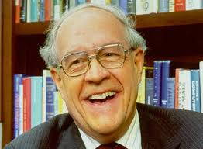
Fred Brook’s Answer
Integration
Productizing
Source: David Parnas, “Software Engineering: Multi-Person Development of Multi-version Programs”
Notes:
Author of the Mythical Man Month
By integrating a product with others one moves from a program to a programming system
By testing, documenting and preparing a program for use and maintenance by other people, one converts a program to a “programming product”

Slide 12
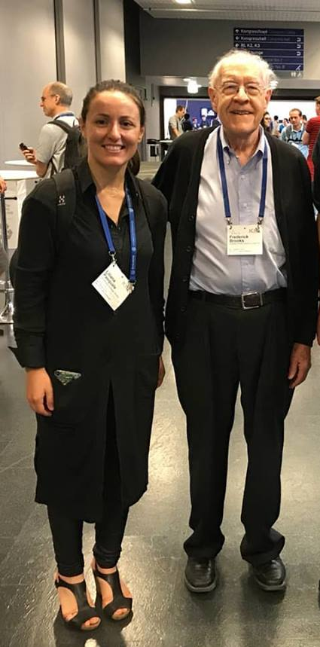
At the 40th International Conference on Software Engineering
(ICSE 2018)

Slide 13

Go to this website
A Little Exercise
https://github.com/tensorflow/tensorflow
Notes:
Github: hosting repository service for software projects
Tensorflow provide libraries to support machine learning (e.g., artificial neural networks)

Slide 14
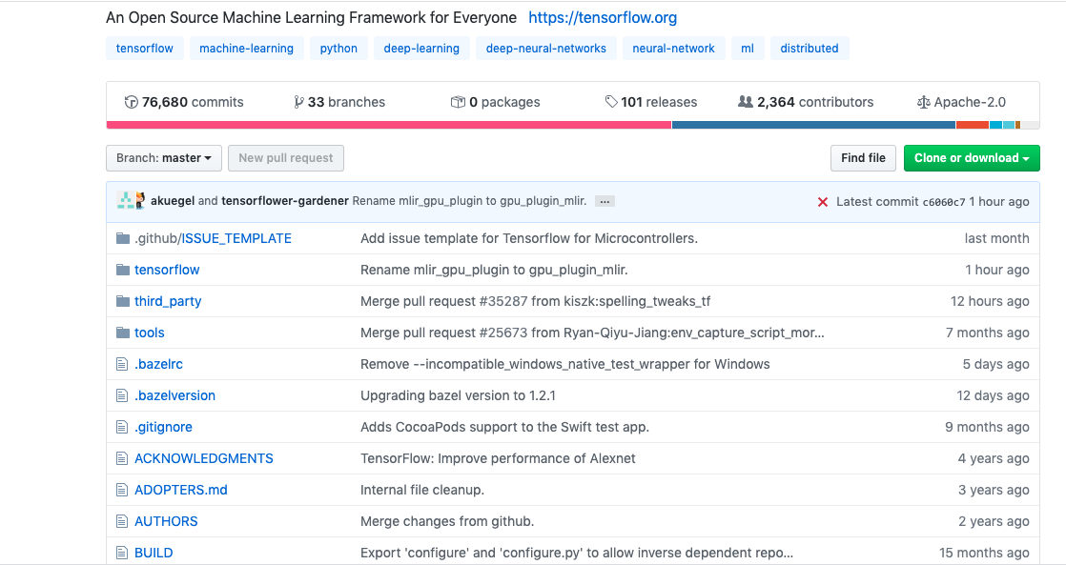
A Closer Look to Tensorflow Project
Many versions
Notes:
Github: hosting repository service for software projects
Tensorflow provide libraries to support machine learning (e.g., artificial neural networks)

Slide 15
A Closer Look to Tensorflow Project
Many developers involved
Notes:
Github: hosting repository service for software projects
Tensorflow provide libraries to support machine learning (e.g., artificial neural networks)

Slide 16
A Closer Look to Tensorflow Project
Many files frequently updated
Notes:
Github: hosting repository service for software projects
Tensorflow provide libraries to support machine learning (e.g., artificial neural networks)

Slide 17
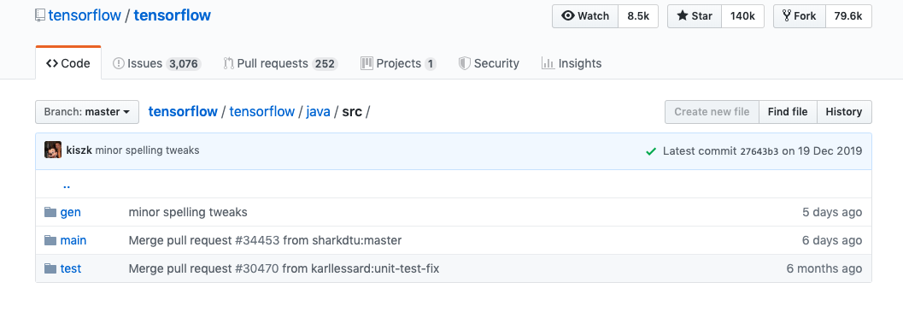
Go To tensorflow/java/src
All parts of the projects developed are also tested
Notes:
Github: hosting repository service for software projects
Tensorflow provide libraries to support machine learning (e.g., artificial neural networks)

Slide 18
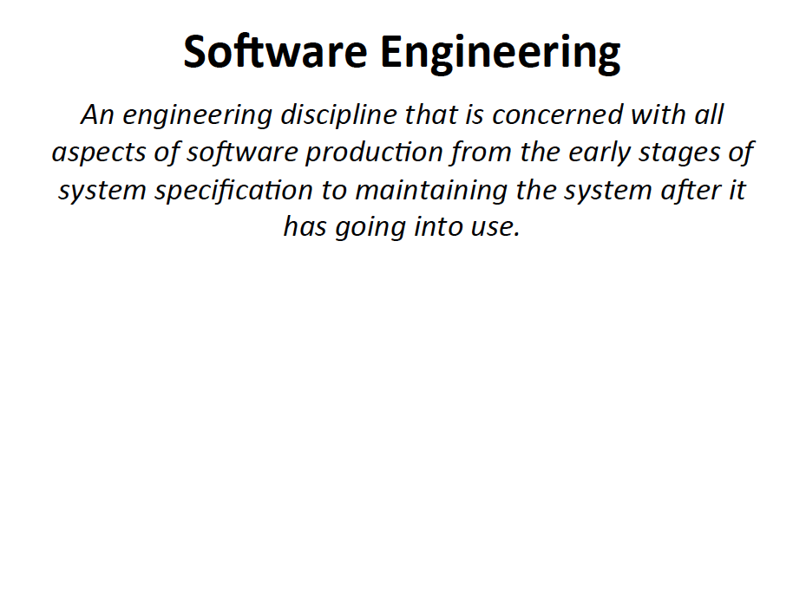

Slide 19
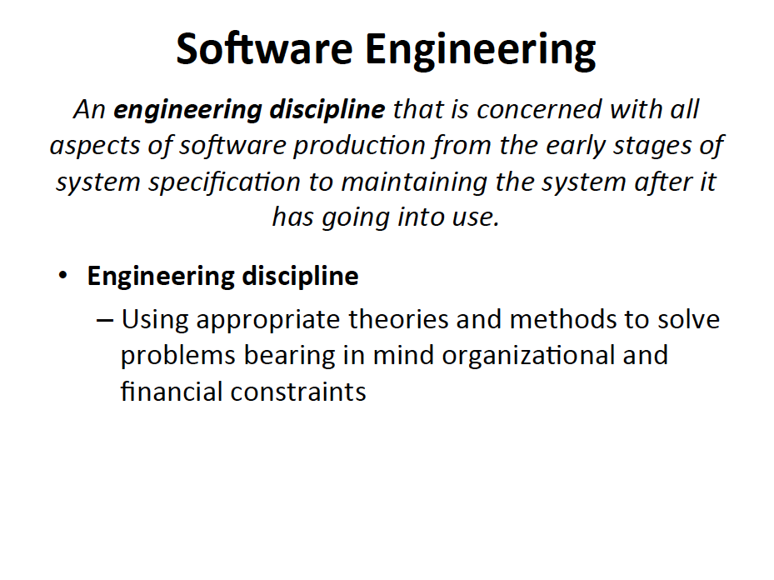

Slide 20
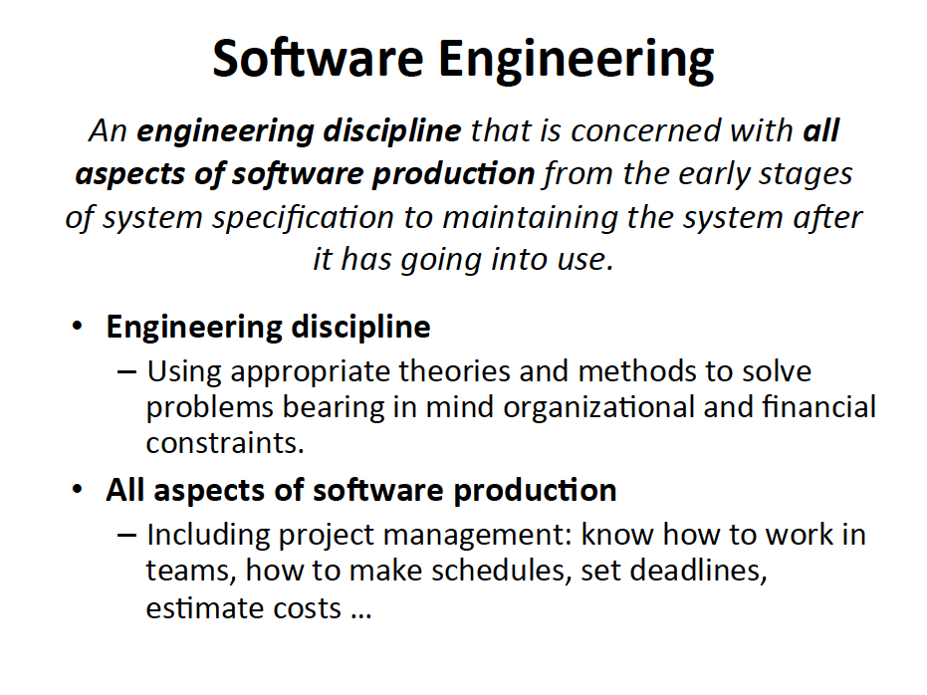

Slide 21
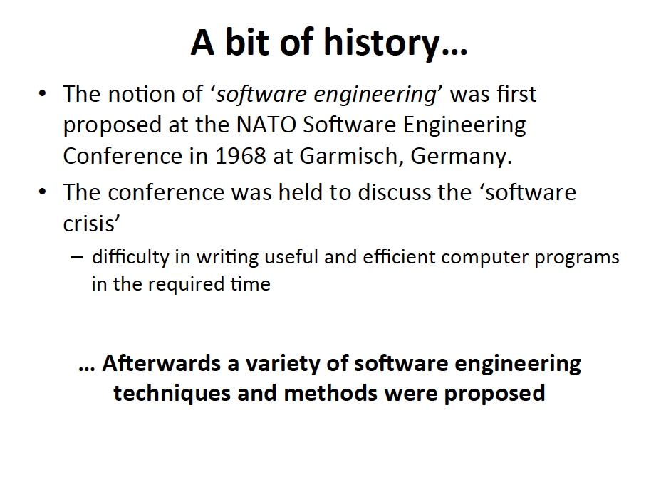

Slide 22
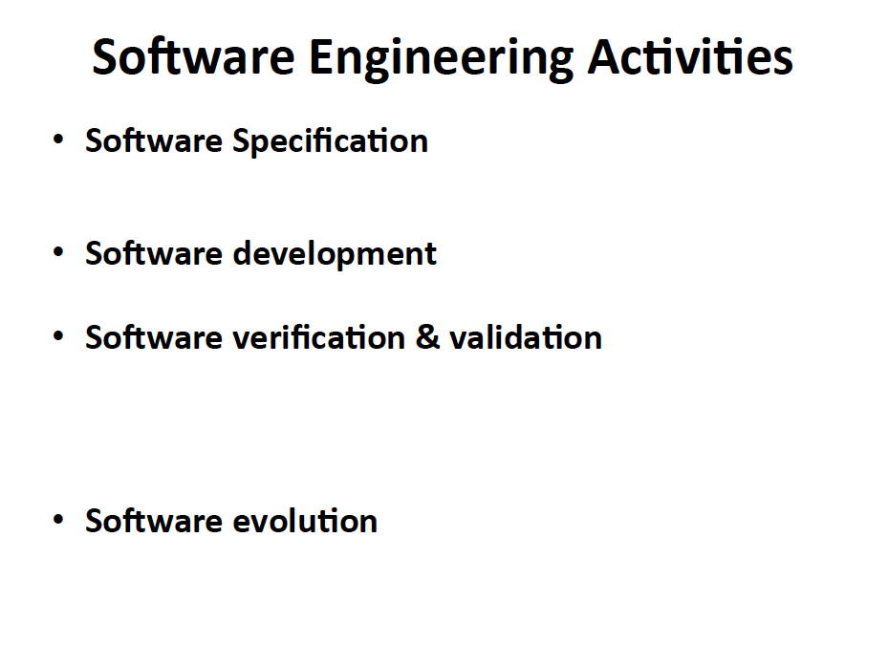
Notes:
The systematic approach that is used in software engineering is sometimes called software process and includes the following activities

Slide 23
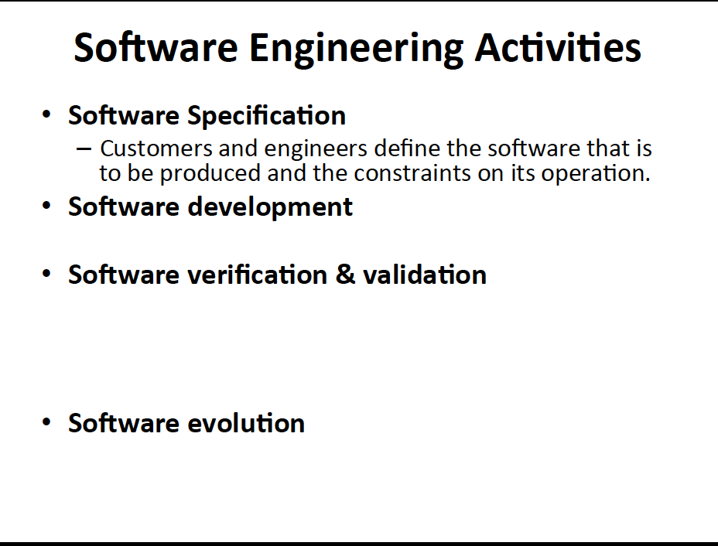

Slide 24
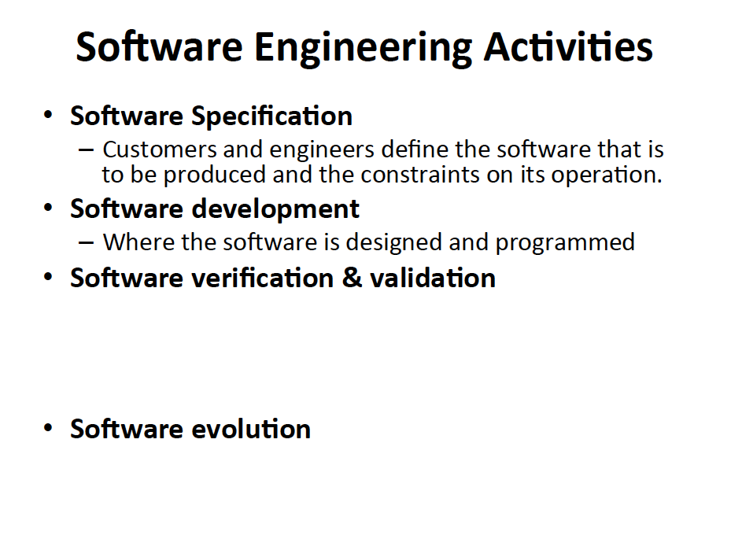

Slide 25
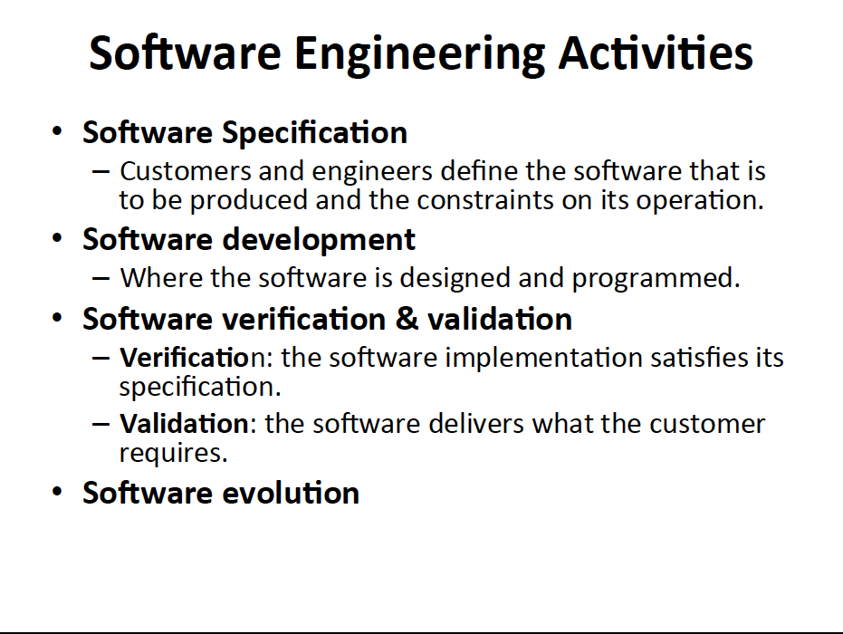

Slide 26
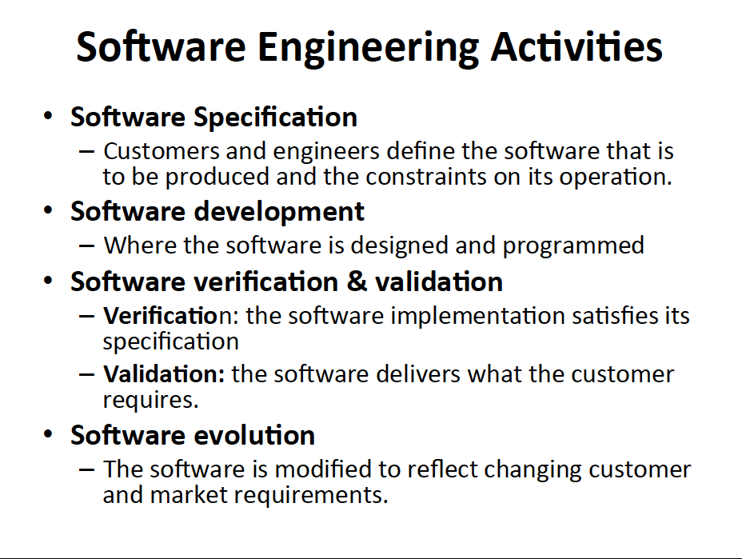

Slide 27
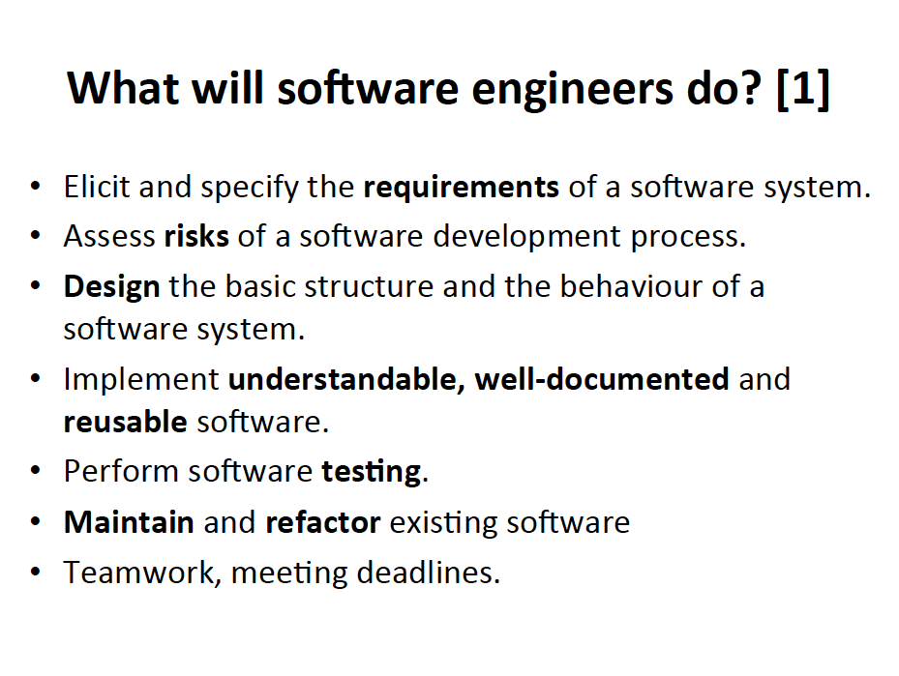

Slide 29
Which Tools Do Software Engineers Use To Develop Code?
They use a tool called Integrated Development Environment
(IDE)
…Visual Studio, CLion, Eclipse, Netbeans, ...

Slide 30
CLion
An open-source software development environment comprising an IDE and a plug-in system to extend it.
Used for building, deploying and managing software across its lifecycle.
Product description available at:
Apply for a Free student pack to download it for free:
https://www.jetbrains.com/clion/
https://www.jetbrains.com/community/education/

Slide 31
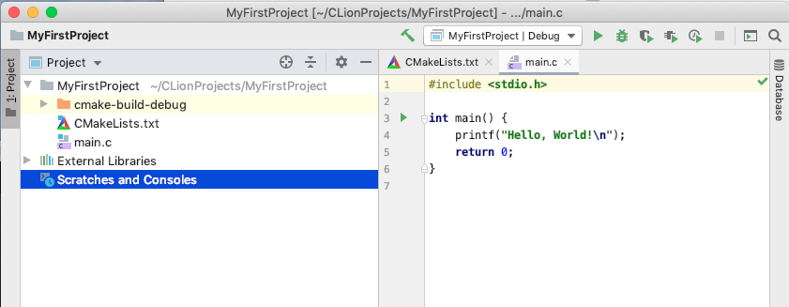
CLion- Basics
Project: a collection of one or more source (as well as header) files
Notes:
Setting up a project allows you to keep track of all the files in an organized way. Generally at the start your projects will consist of a single source file.
However as you gain experience and work on more complex projects you wioll have prokects containing many source files and dealing with header files as well.

Slide 32
CLion- Basics
Source: Contains the files with the source code of your program (.c file)
Notes:
Setting up a project allows you to keep track of all the files in an organized way. Generally at the start your projects will consist of a single source file.
However as you gain experience and work on more complex projects you wioll have prokects containing many source files and dealing with header files as well.

Slide 33
CLion- Basics
Header: Contains library files (.h files). A library is a collection of functions that are called to perform specific tasks, such as doing math, etc.
Notes:
Setting up a project allows you to keep track of all the files in an organized way. Generally at the start your projects will consist of a single source file.
However as you gain experience and work on more complex projects you wioll have prokects containing many source files and dealing with header files as well.

Slide 34
Compiling and Running Projects
Build
Run
Debug
Notes:
Setting up a project allows you to keep track of all the files in an organized way. Generally at the start your projects will consist of a single source file.
However as you gain experience and work on more complex projects you will have projects containing many source files and dealing with header files as well.

Slide 35
Software Engineers Also Write “Clean Code”

Slide 36
A Few Tips to Write Clean Code
Naming conventions
Easy to understand what the variable represents.
Easy to understand the variable scope.
Source: https://www.codeschool.com/blog/2015/09/29/10-ways-to-write-cleaner-code/

Slide 37
Naming Conventions Examples
char name[] = “George Orwell”
char fb_username [] = “George Orwell”
//constant values are in all caps and
//separated with underscores
int I_WINDOW_SIZE =900;
Source: https://www.codeschool.com/blog/2015/09/29/10-ways-to-write-cleaner-code/

Slide 38
A Few Tips to Write Clean Code
Say What You Mean
int checkNum(int n)
{
if(n<max){
return -1;
}
else return 1;
}
int MIN_VALUE = 5;
int valueIsTooLow(int value)
{
if(value < MIN_VALUE)
return -1;
else return 1;
}
Source: https://www.codeschool.com/blog/2015/09/29/10-ways-to-write-cleaner-code/

Slide 39
A Few Tips to Provide Comments
Program comments are explanatory notes for the humans reading a program.
Why so important?
Fundamental software engineering practice critical for efficient software development
Acts as a specification of behaviour for other engineers who might need to read, understand or modify your code.
When should you add comments?
At the beginning of each C Source file
To explain the overall purpose of the program. 2-3 sentences will suffice.
Just before each method declaration
To explain its purpose and any method parameters
When your code is unusual and obscure
When something is important and not obvious, it merits a comment.
Source: Previous year material by Prof. P Cunningham

Slide 40
Module Organization

Slide 41
Schedule
Lectures:
One lecture per week. Tuesdays, 13:00-13:50
Location: H1.37
Labs:
Fridays, 11:00-12:50
Room B108 (ART) → Surnames Aldabous to Davidov
Room B109 (ART) → Surnames Dempsey to Zhao

Slide 42
Objectives
To introduce you to the field of software engineering

Slide 43
Objectives
To introduce you to the field of software engineering
Gain experience of some key software development practices
Good programming conventions
Software development (in C)

Slide 44
Objectives
To introduce you to the field of software engineering
Gain experience of some key software development practices
Good programming conventions
Software development (in C)
Using an IDE –> CLion

Slide 45
Objectives
To introduce you to the field of software engineering
Gain experience of some key software development practices
Good programming conventions
Software development (in C)
Using an IDE –> CLion
Distributed version repositories → Git

Slide 46
Objectives
To introduce you to the field of software engineering
Gain experience of some key software development practices
Good programming conventions
Software development (in C)
Using an IDE –> CLion
Distributed version repositories → Git
Testing
Teamwork

Slide 47
Outline of the Module
Part 1: Arrays, Strings, I/O and Basic Algorithms
Part 2: Git, Basic Structures, Pointers, Dynamic Data Structures
Part 3: Testing

Slide 48
Outline of the Module
Part 1: Arrays, Strings, I/O and Basic Algorithms
Individual Assignment (40%)
Deadline: Feb 28
Part 2: Git, Basic Structures, Pointers, Dynamic Data Structures
Group Assignment (40%)
Deadline: Apr 21
Part 3: Testing
Individual Assignment (15%)
Deadline: May 1

Slide 49
Enrollment on Brightspace
You should be automatically enrolled in the module on Brightspace.
Lecture notes will be posted immediately before or after each lecture
Assignments and any other material will be posted as we progress through the module
Announcement will be made on Brightspace, so check the module page frequently!

Slide 50
A Few Advices…
Attend lectures and labs:
LABs ARE MANDATORY and attendance contributes to 5% of the mark
Make sure your assignment does not have compilation errors
Results in 0 marks for the assignment in question
Submit your assignment on time

Slide 51
… And Some More Advices
Don’t be shy: if there is something you don’t fully understand
Ask demonstrator of your table
Discuss with others at your table
Use the “Module Questions” forum on Brightspace
Use Google
Get familiar with online resources (social coding)
Stackoverflow, cppreference, wikihow

Slide 52
Evaluation of the Module
For each assignment you are asked to
Use the CLion Software Development Environment
Write clean code
Separate your code in various modules and files wherever possible
Use a distributed version control system to work collaboratively
Only for assignment 2
Specific requirements for each assignment will be provided in due course.

Slide 53

Assessment Submission
Deliverable deadlines are on the main module page
Late submissions
NOT by e-mail
Brightspace assignments will remain open for submission after due dates to accommodate late submissions, but penalties will apply:
Up to 1 week late: 10% deduction
Up to 2 weeks late: 20% deduction
More than 2 weeks late: 50% deduction

Slide 54
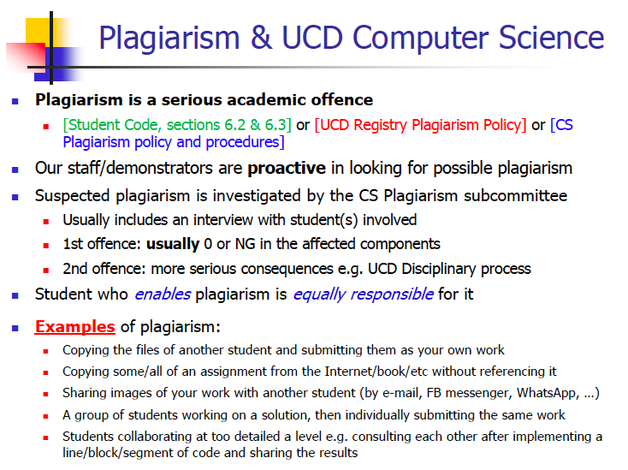

Slide 55
What did we Learn Today?
Difference between software engineering and software development
What Software Engineers Do
Integrated Development Environment (CLion)
Writing clean code
Module Organization

